Slide 1
Science Express Spectral Tubes
Spectral tubes contain gases that emit light when high voltage electricity is passed through them. A neon sign would be an example of this phenomenon. Different molecules will emit different colors of light when electricity is passed through them. The wavelengths of light emitted are called the emission spectrum. Each molecule has a unique emission spectrum. The molecules present in an unknown sample can be determined by viewing the sample’s emission spectrum and comparing it to the spectra of known samples.

Slide 2
To get a gas to emit visible light, a high voltage must be passed through it. A spectral tube holder is a device that can take electricity from an electrical outlet and greatly increase the voltage before passing it through a spectral tube that contains the gas sample to be viewed. Click on the video below to see how it works.

Slide 3
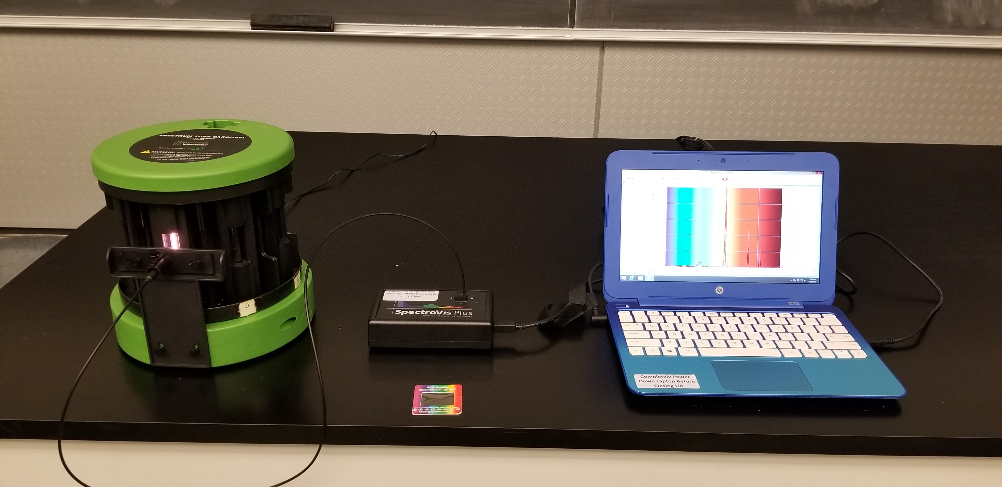
In this demonstration emission spectra will be observed with a linear diffraction grating card and with a visible spectrophotometer. Both are shown in the picture below.
Spectral tube holder
Visible Spectrophotometer
linear diffraction grating

Slide 4
The next slides will show the emission spectra of 7 different gas: carbon dioxide, helium, nitrogen, hydrogen, argon, helium, and air. The spectra from the visible spectrophotometer and a linear diffraction grating will be shown. Note that the spectra of the spectrophotometer and diffraction grating are backwards from each other.

Slide 5
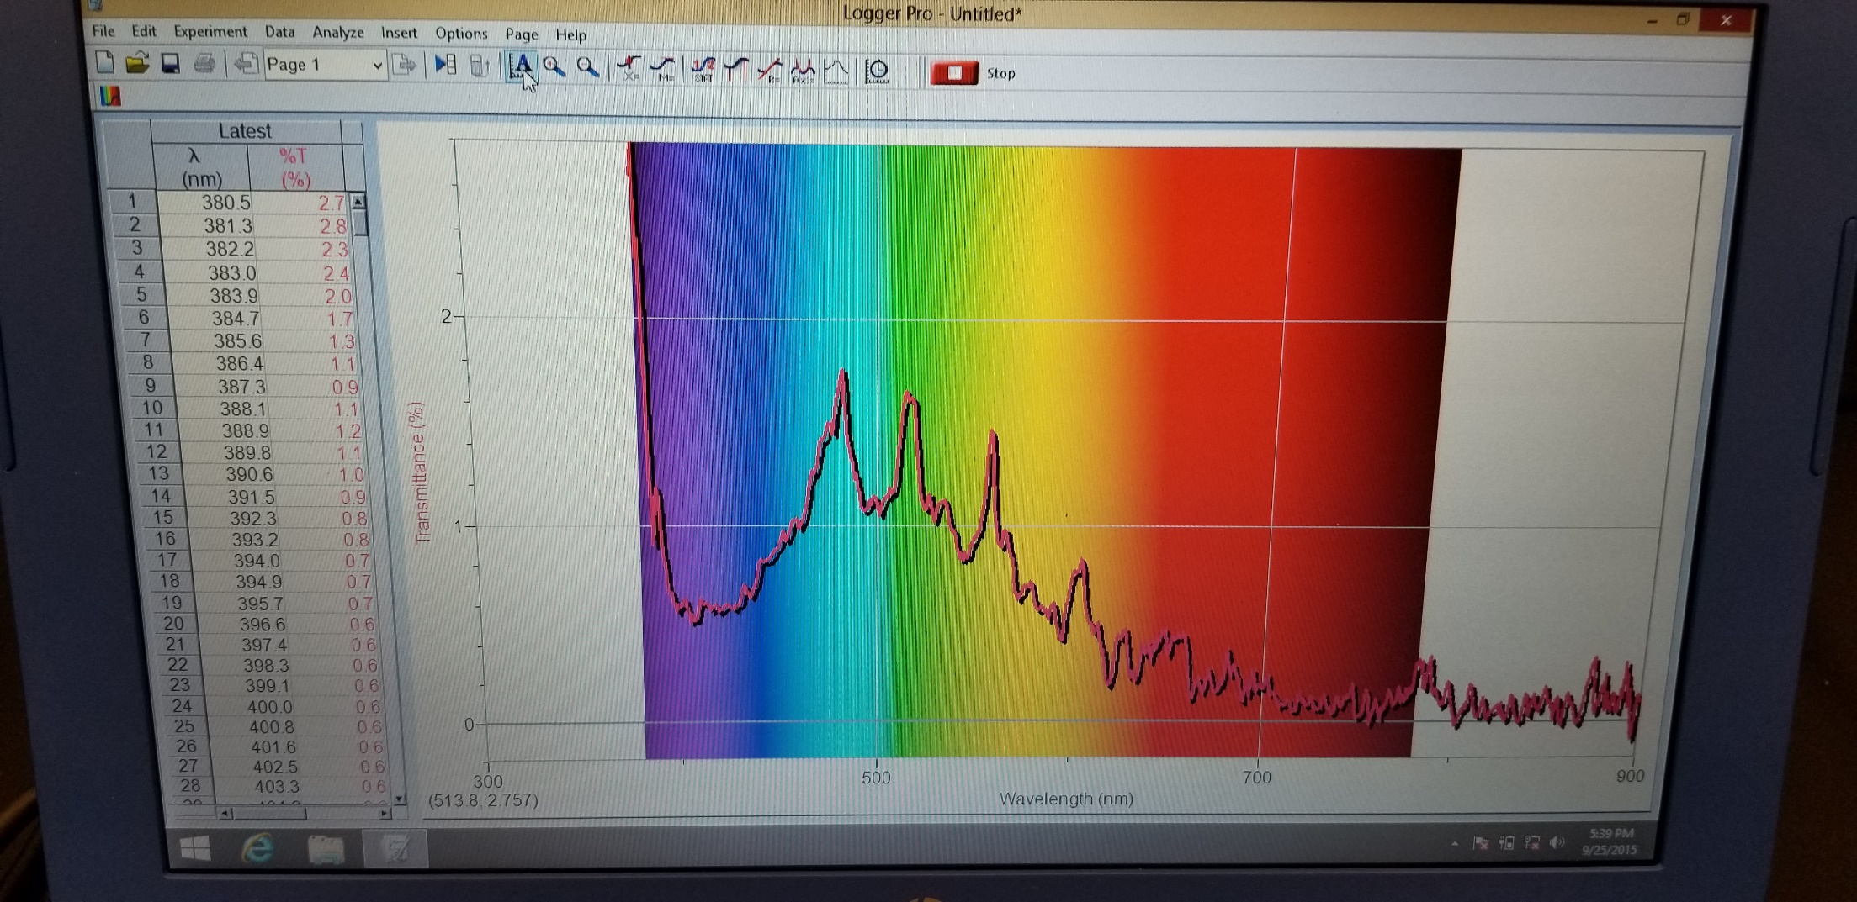
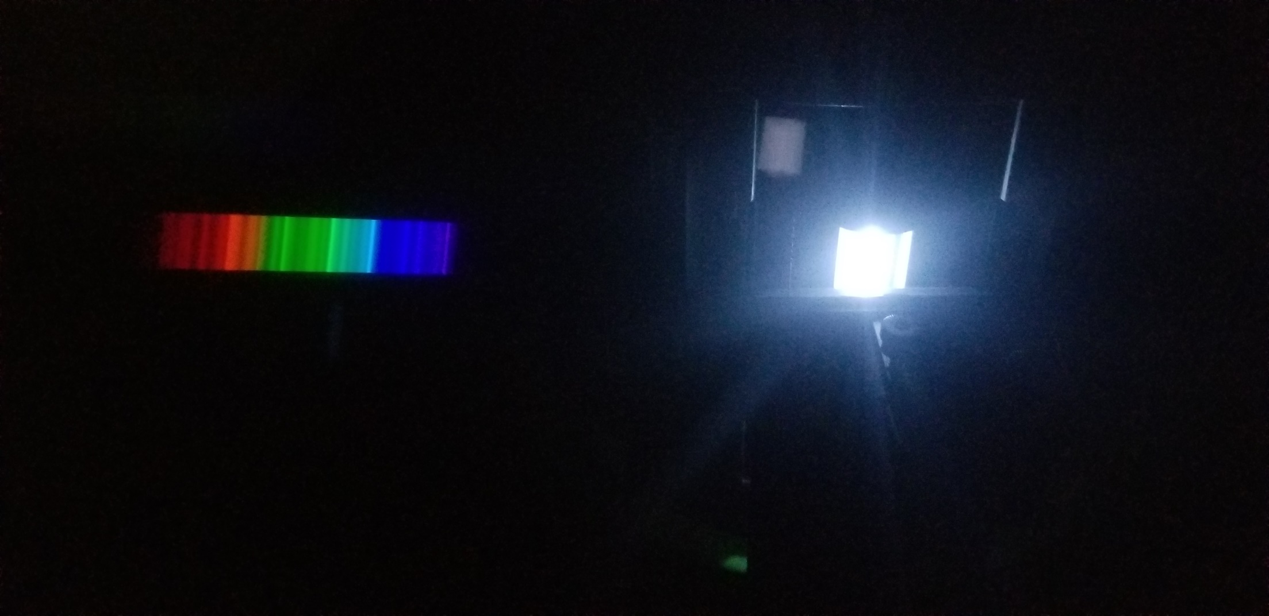
Carbon Dioxide
Visible spectrophotometer Linear diffraction grating

Slide 6
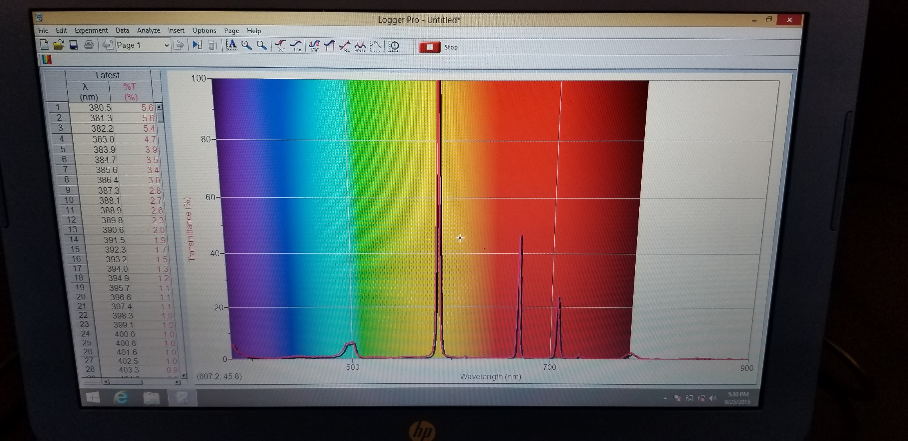
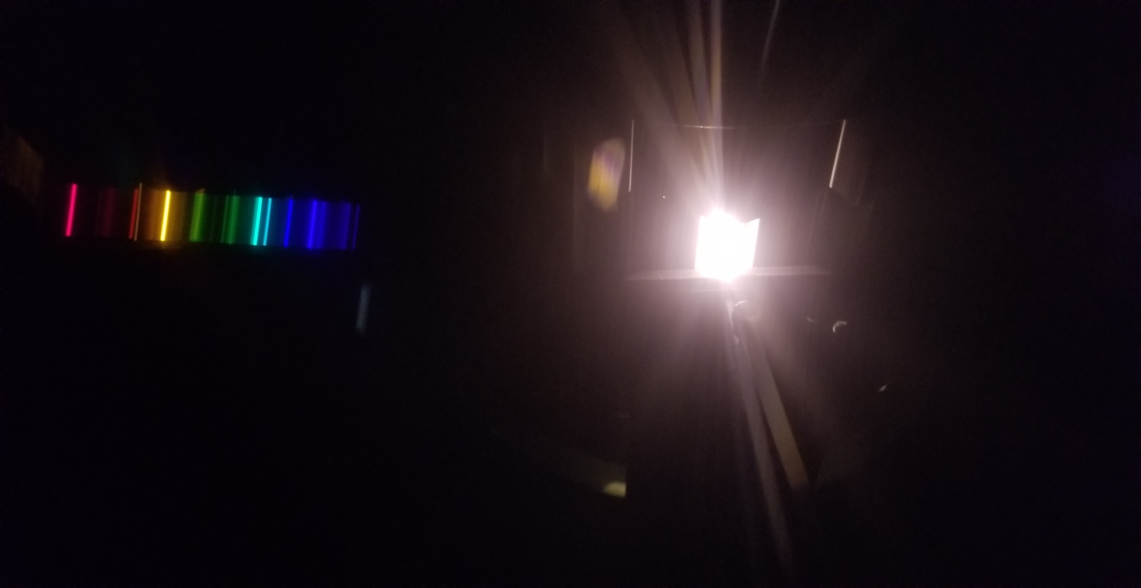
Helium
Visible spectrophotometer Linear diffraction grating

Slide 7
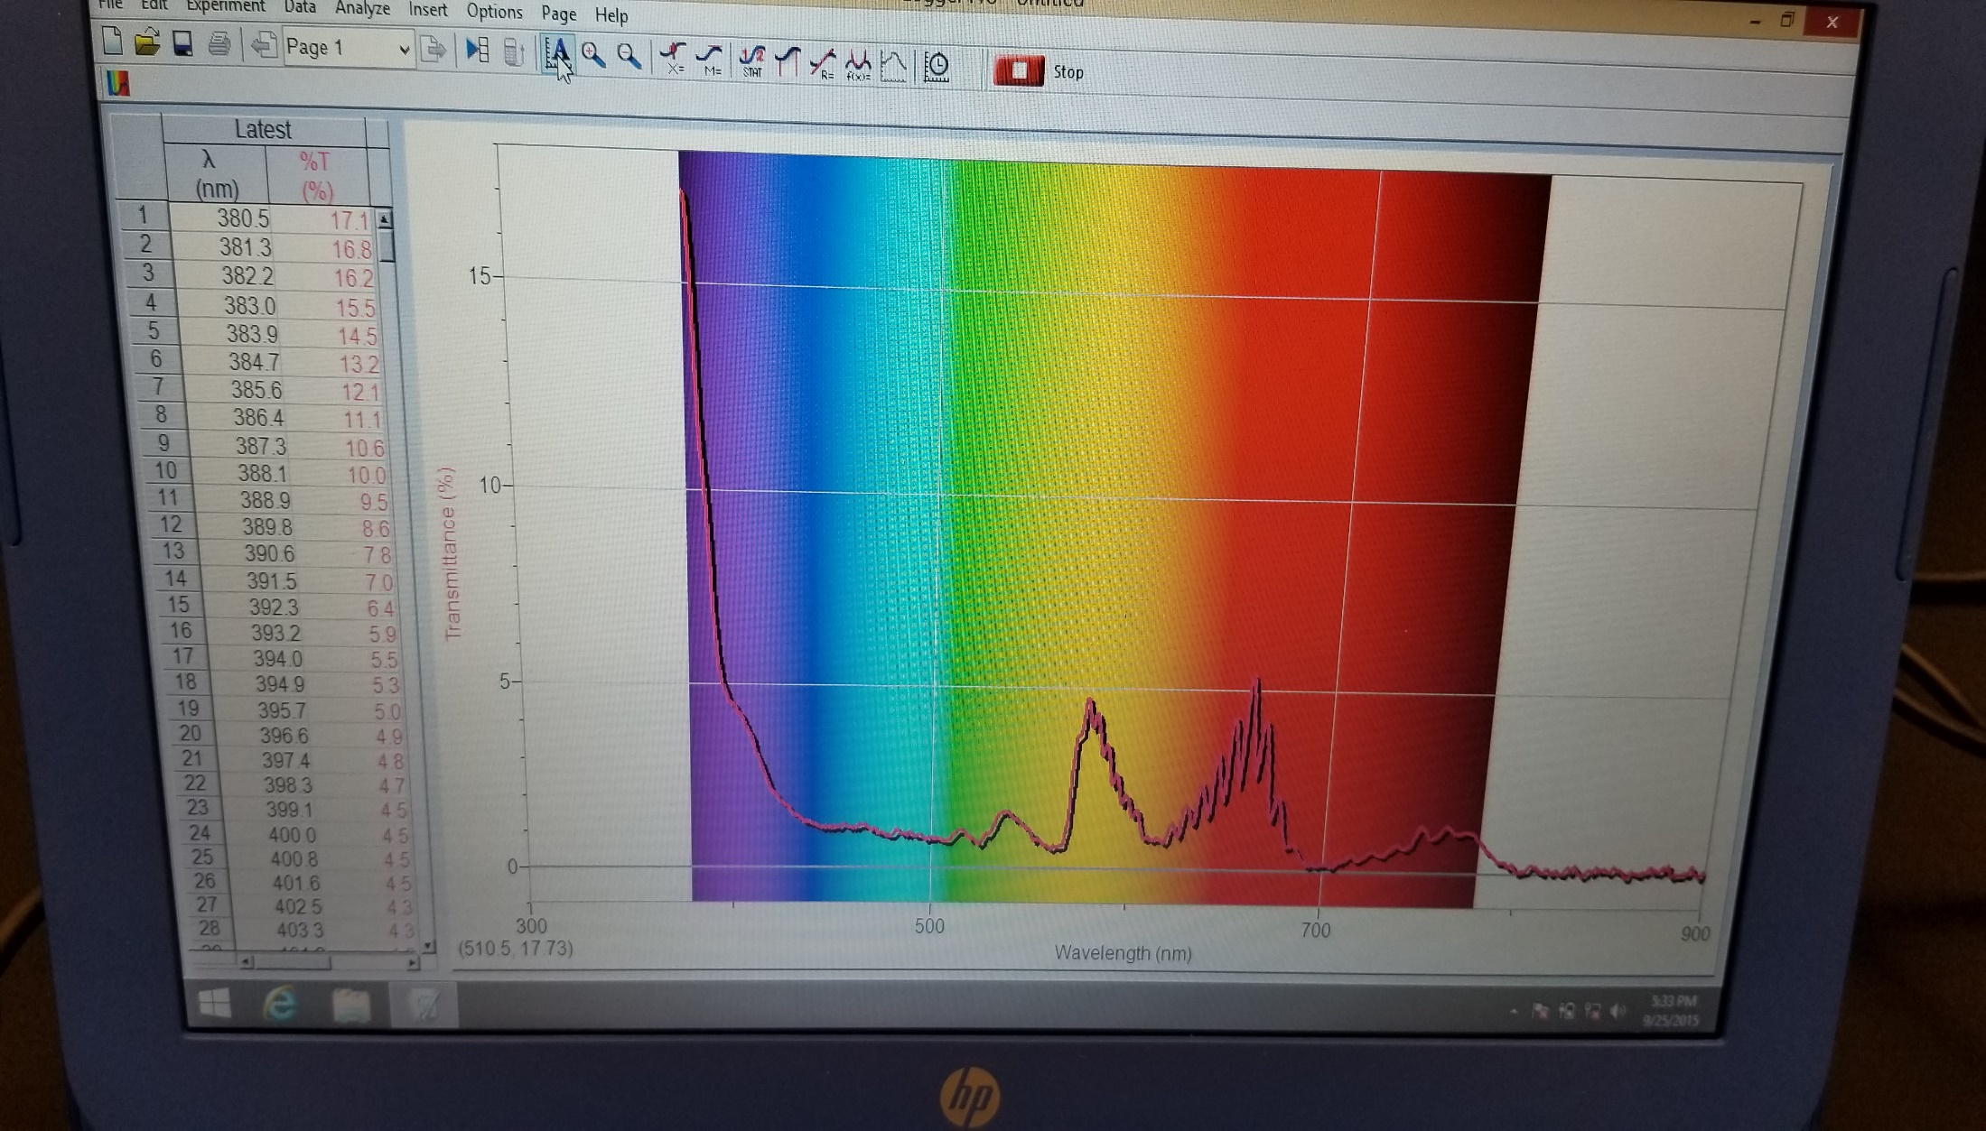
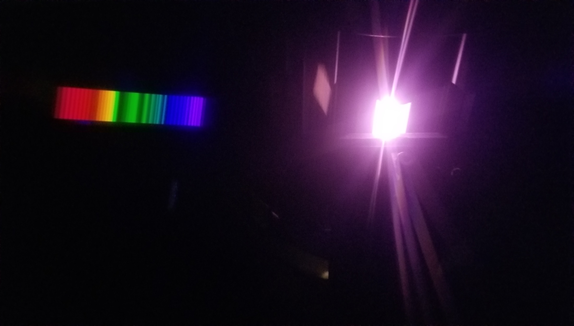
Nitrogen
Visible spectrophotometer Linear diffraction grating

Slide 8
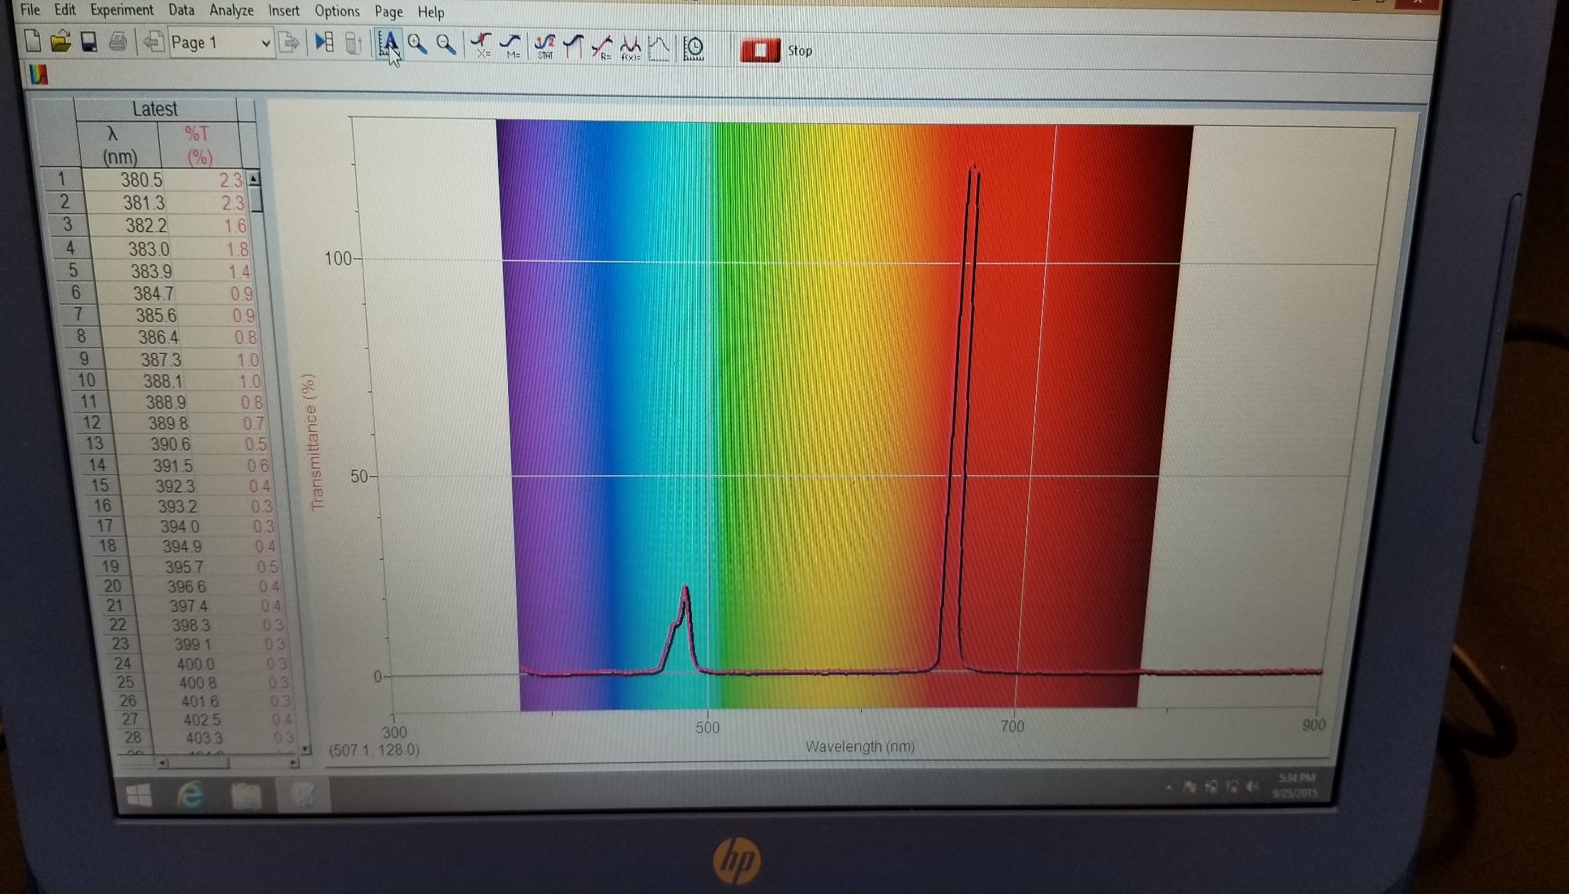
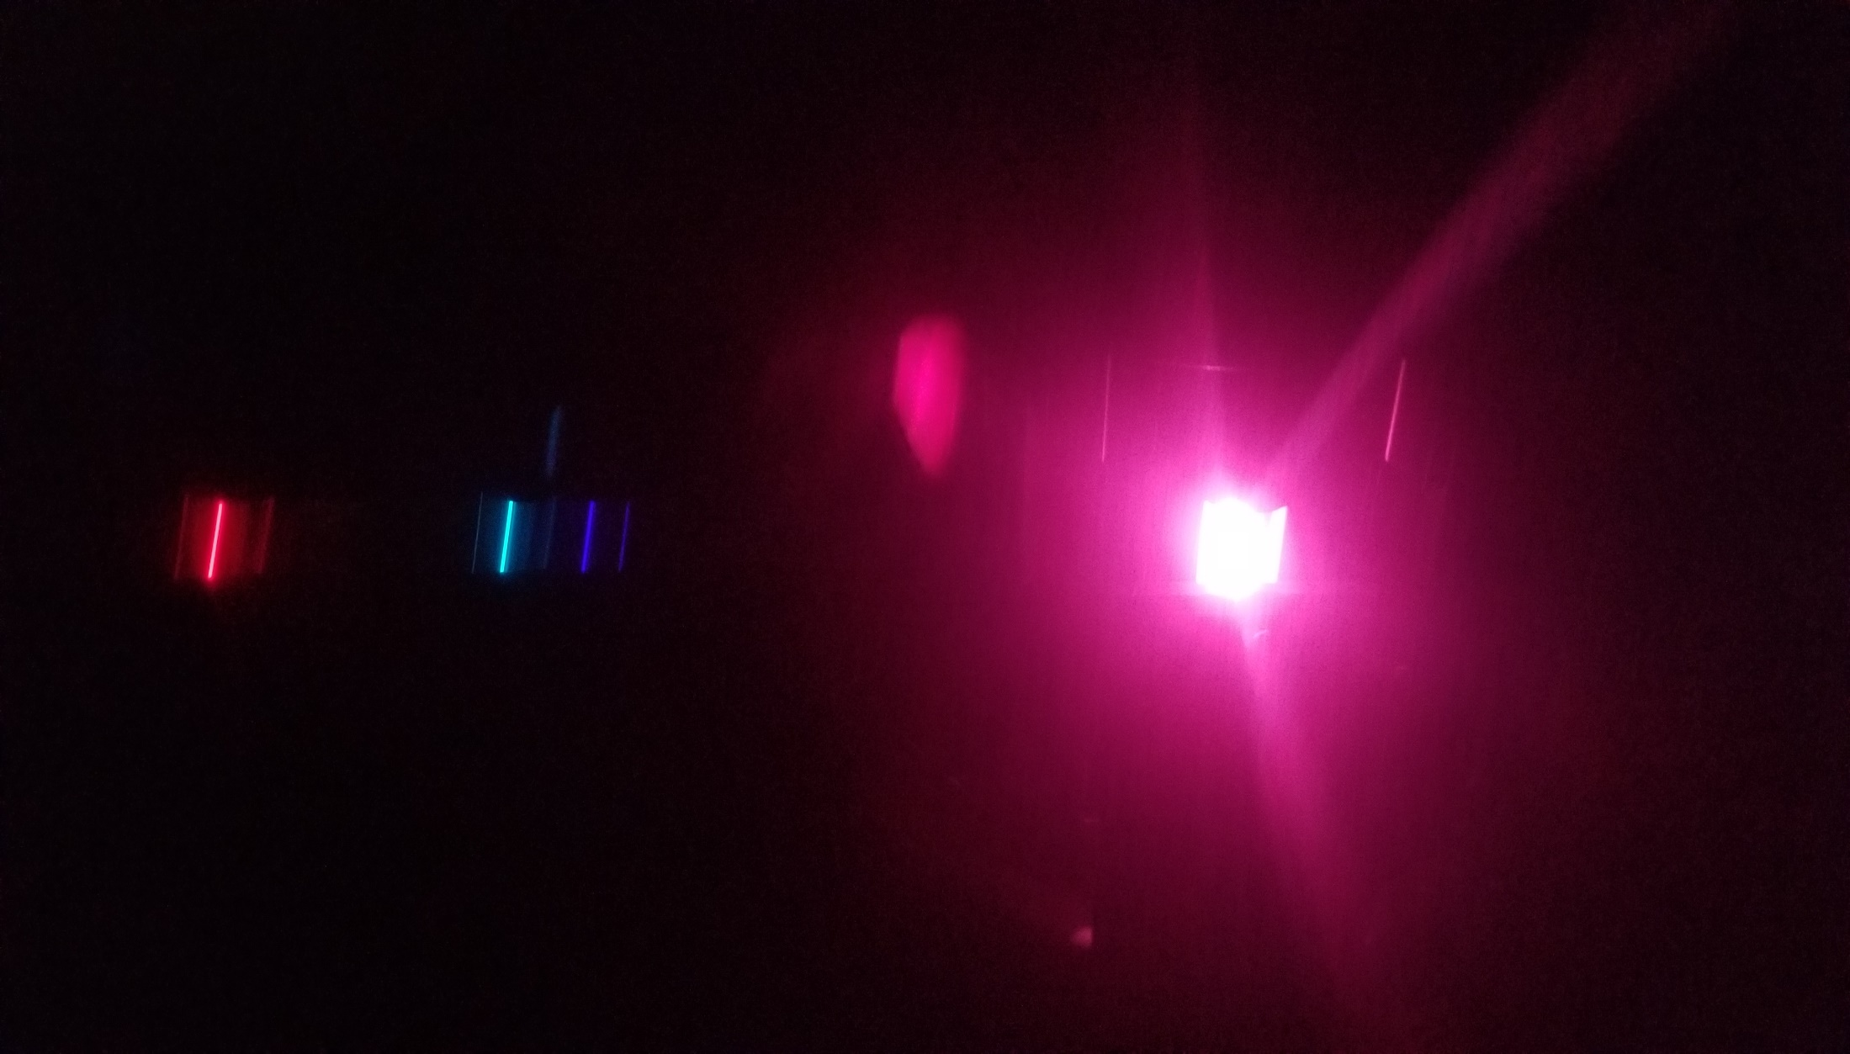
Hydrogen
Visible spectrophotometer Linear diffraction grating

Slide 9
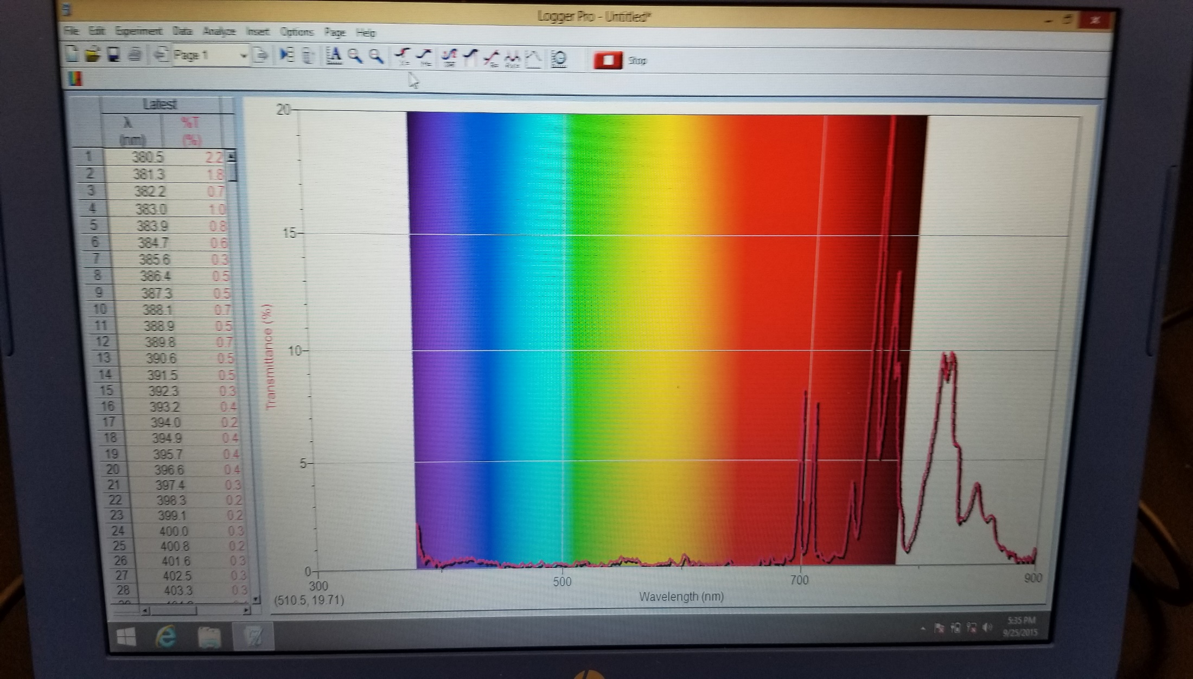
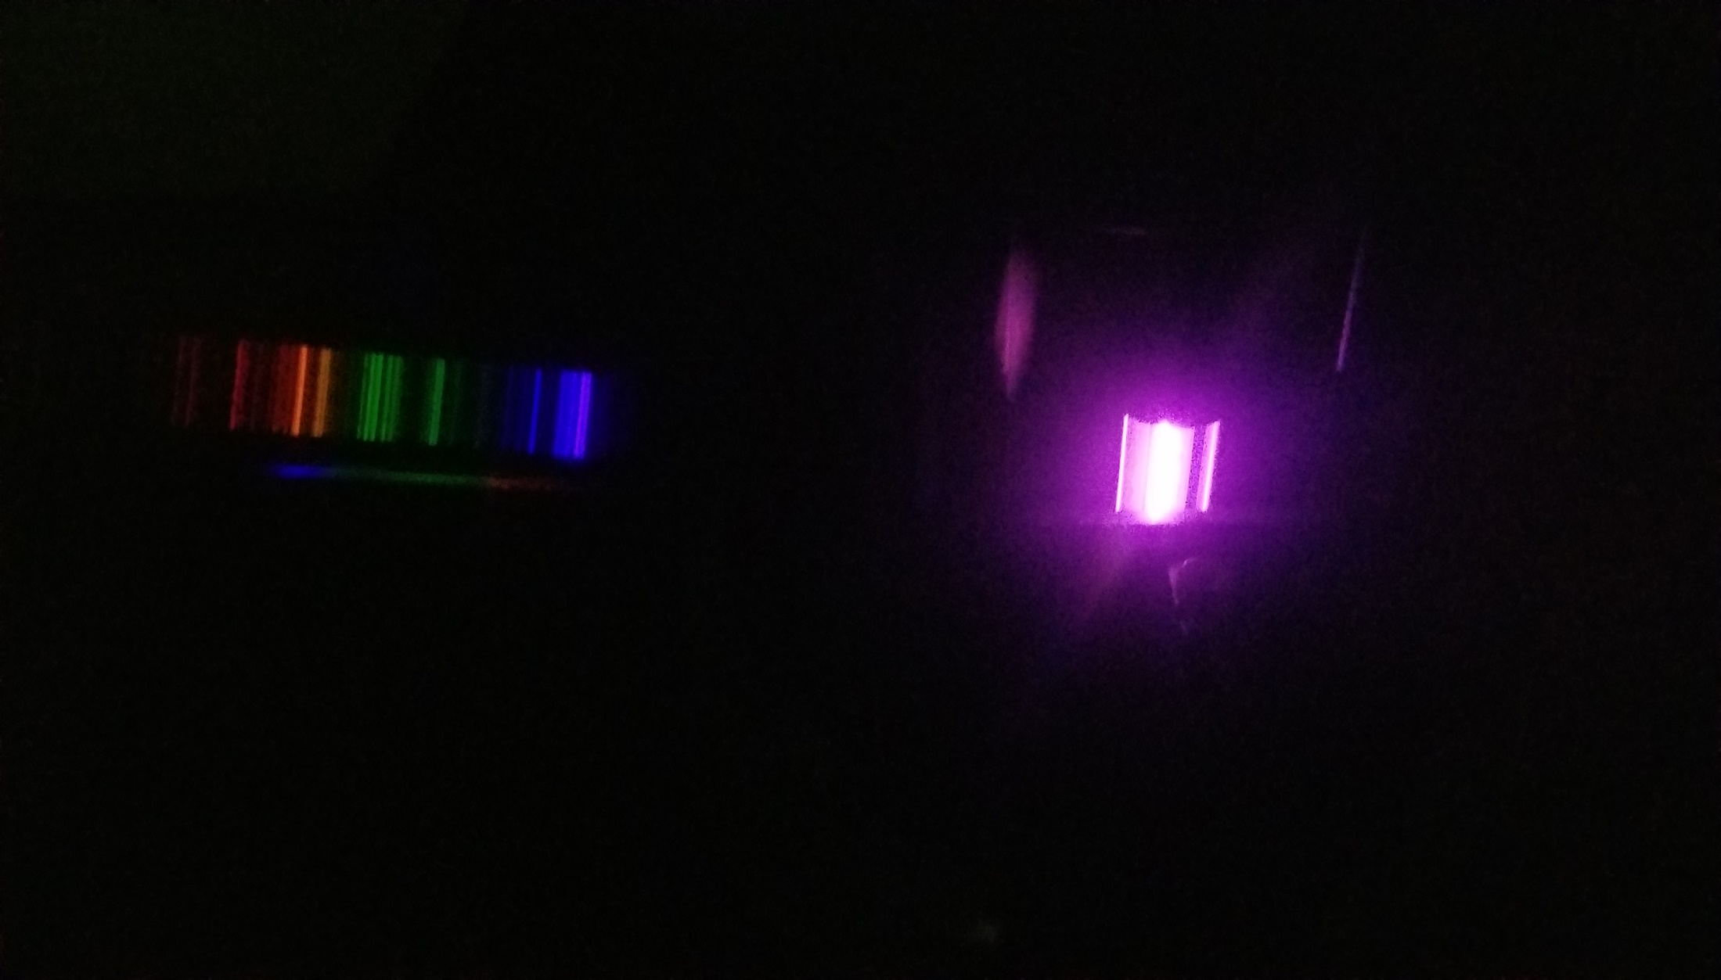
Argon
Visible spectrophotometer Linear diffraction grating

Slide 10
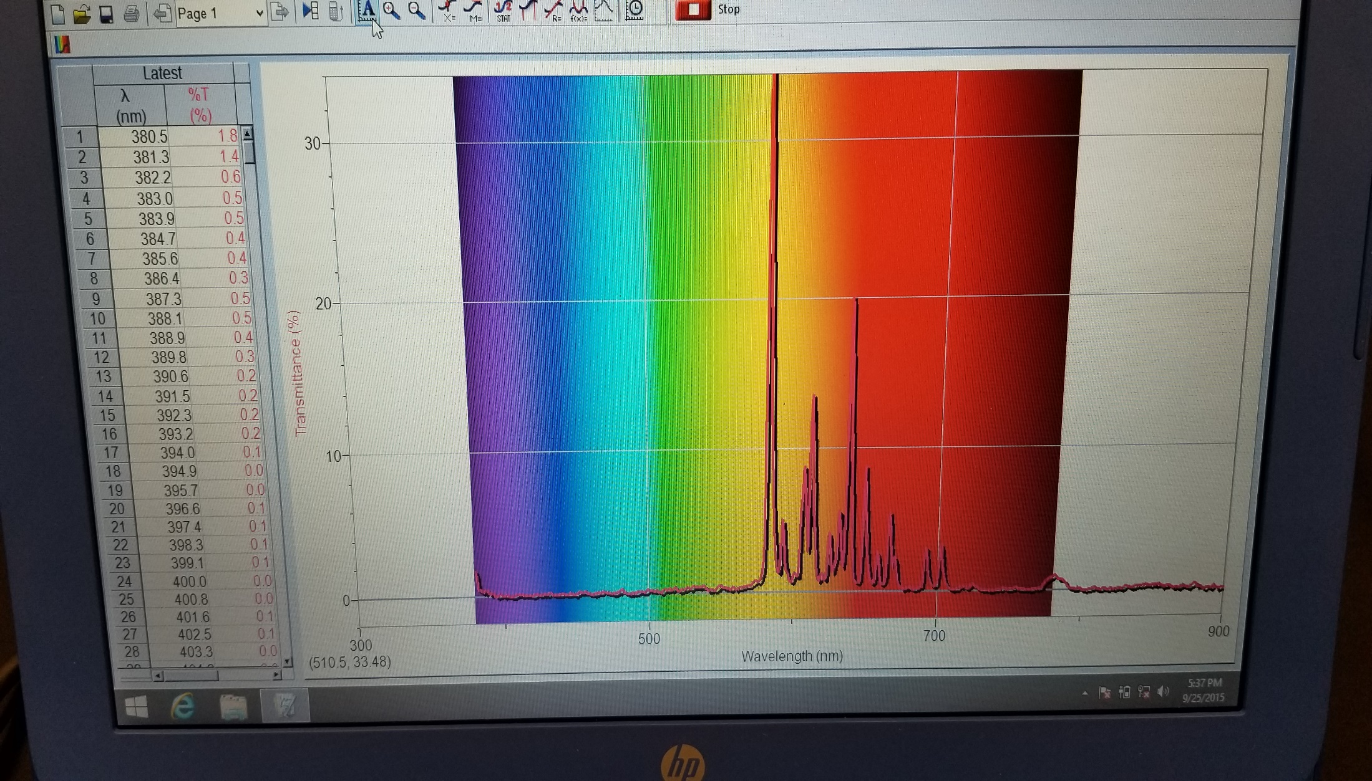
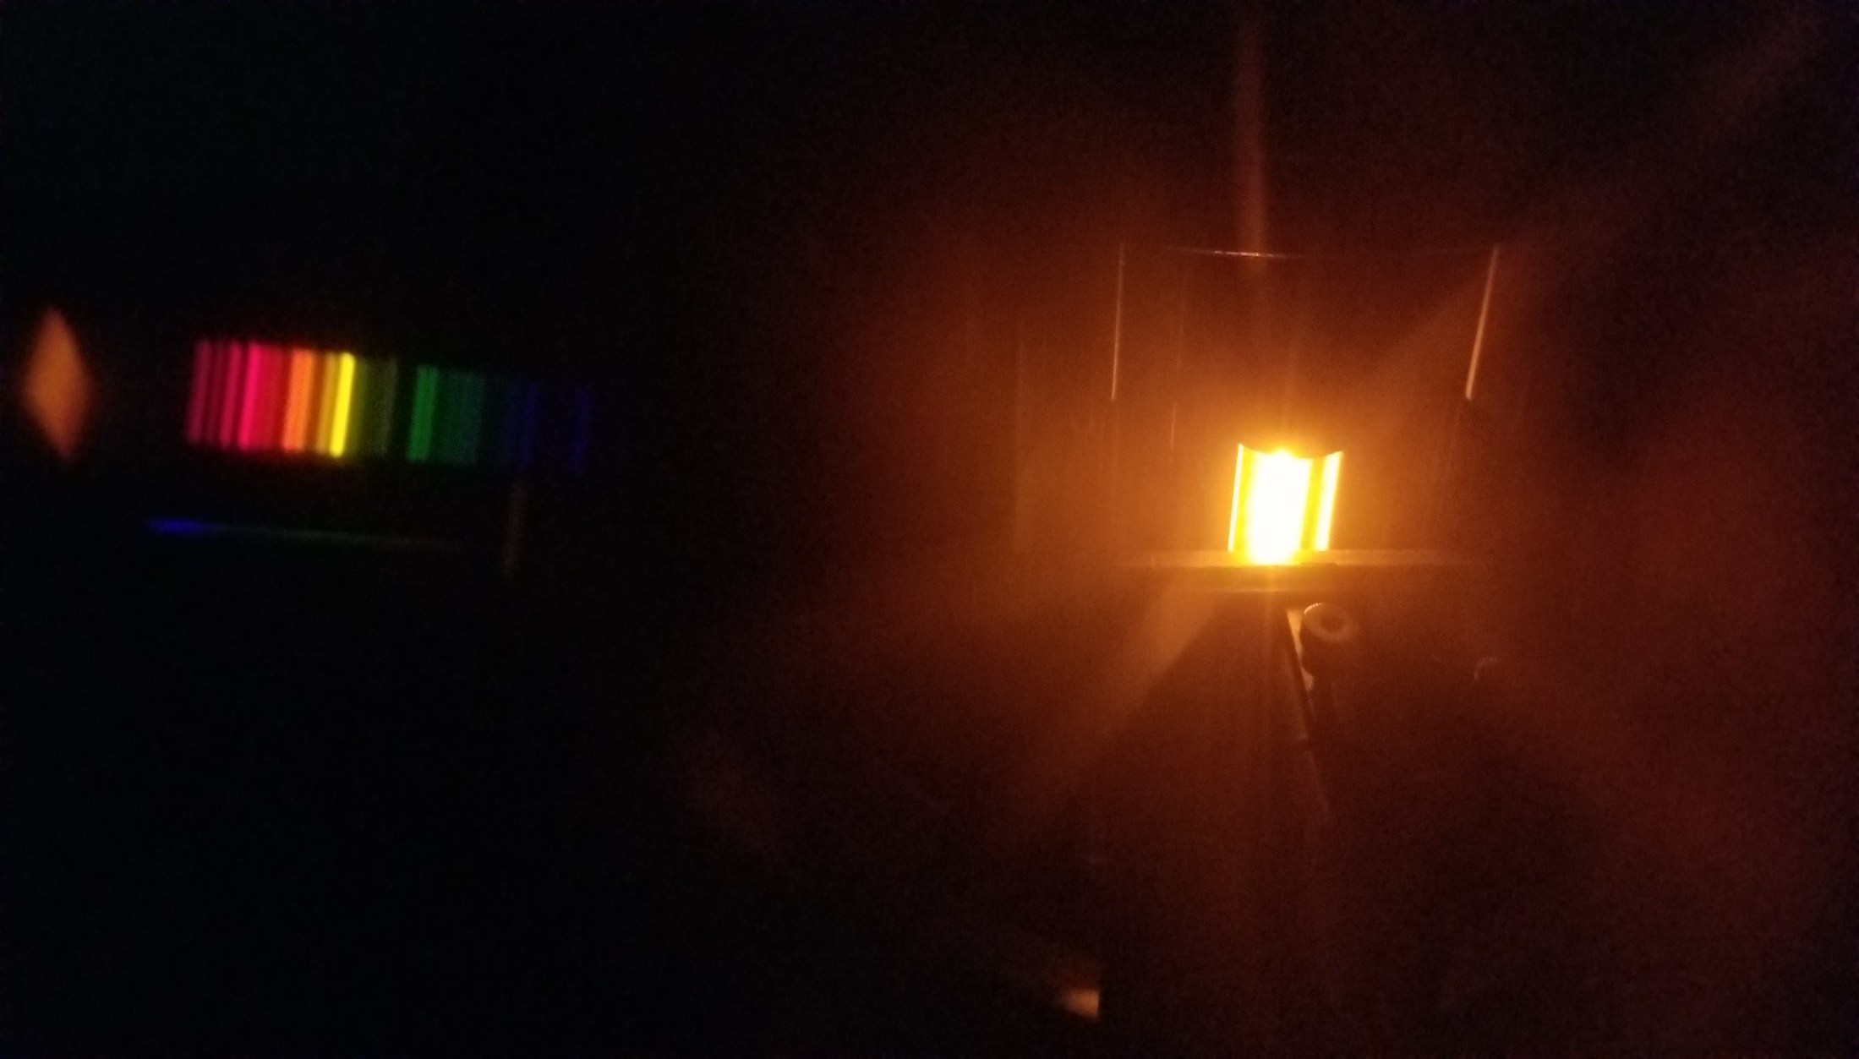
Neon
Visible spectrophotometer Linear diffraction grating

Slide 11
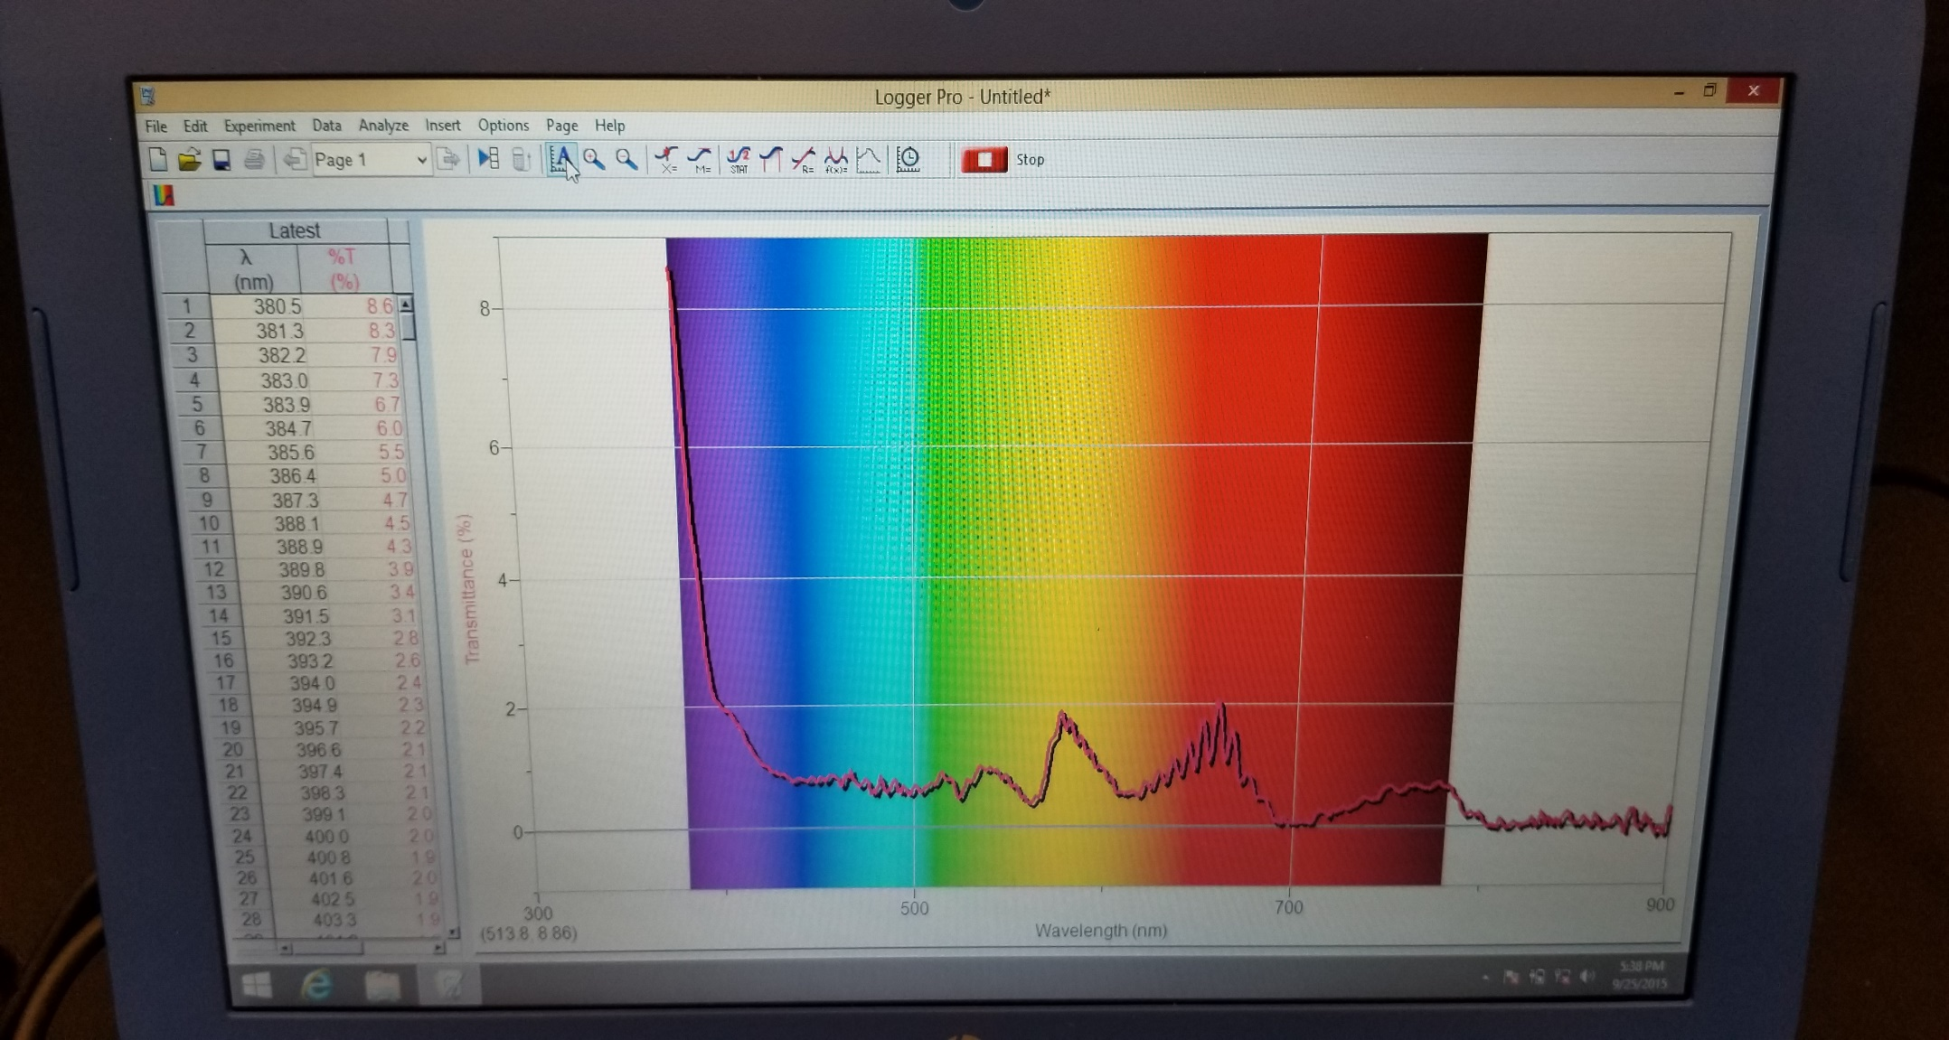
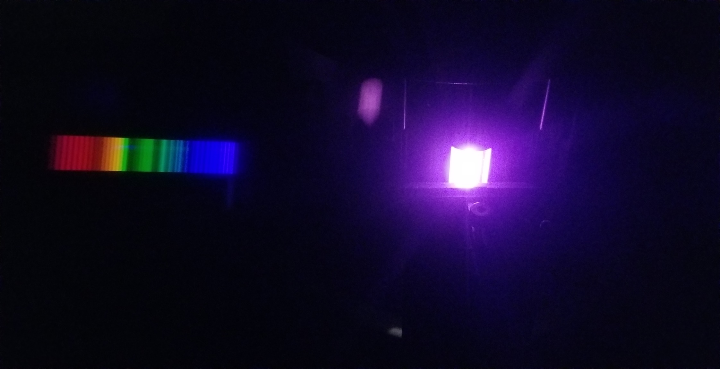
Air
Visible spectrophotometer Linear diffraction grating

Slide 12
This presentation was produced by:
The Purdue University
Science Express Program

